Slide 1

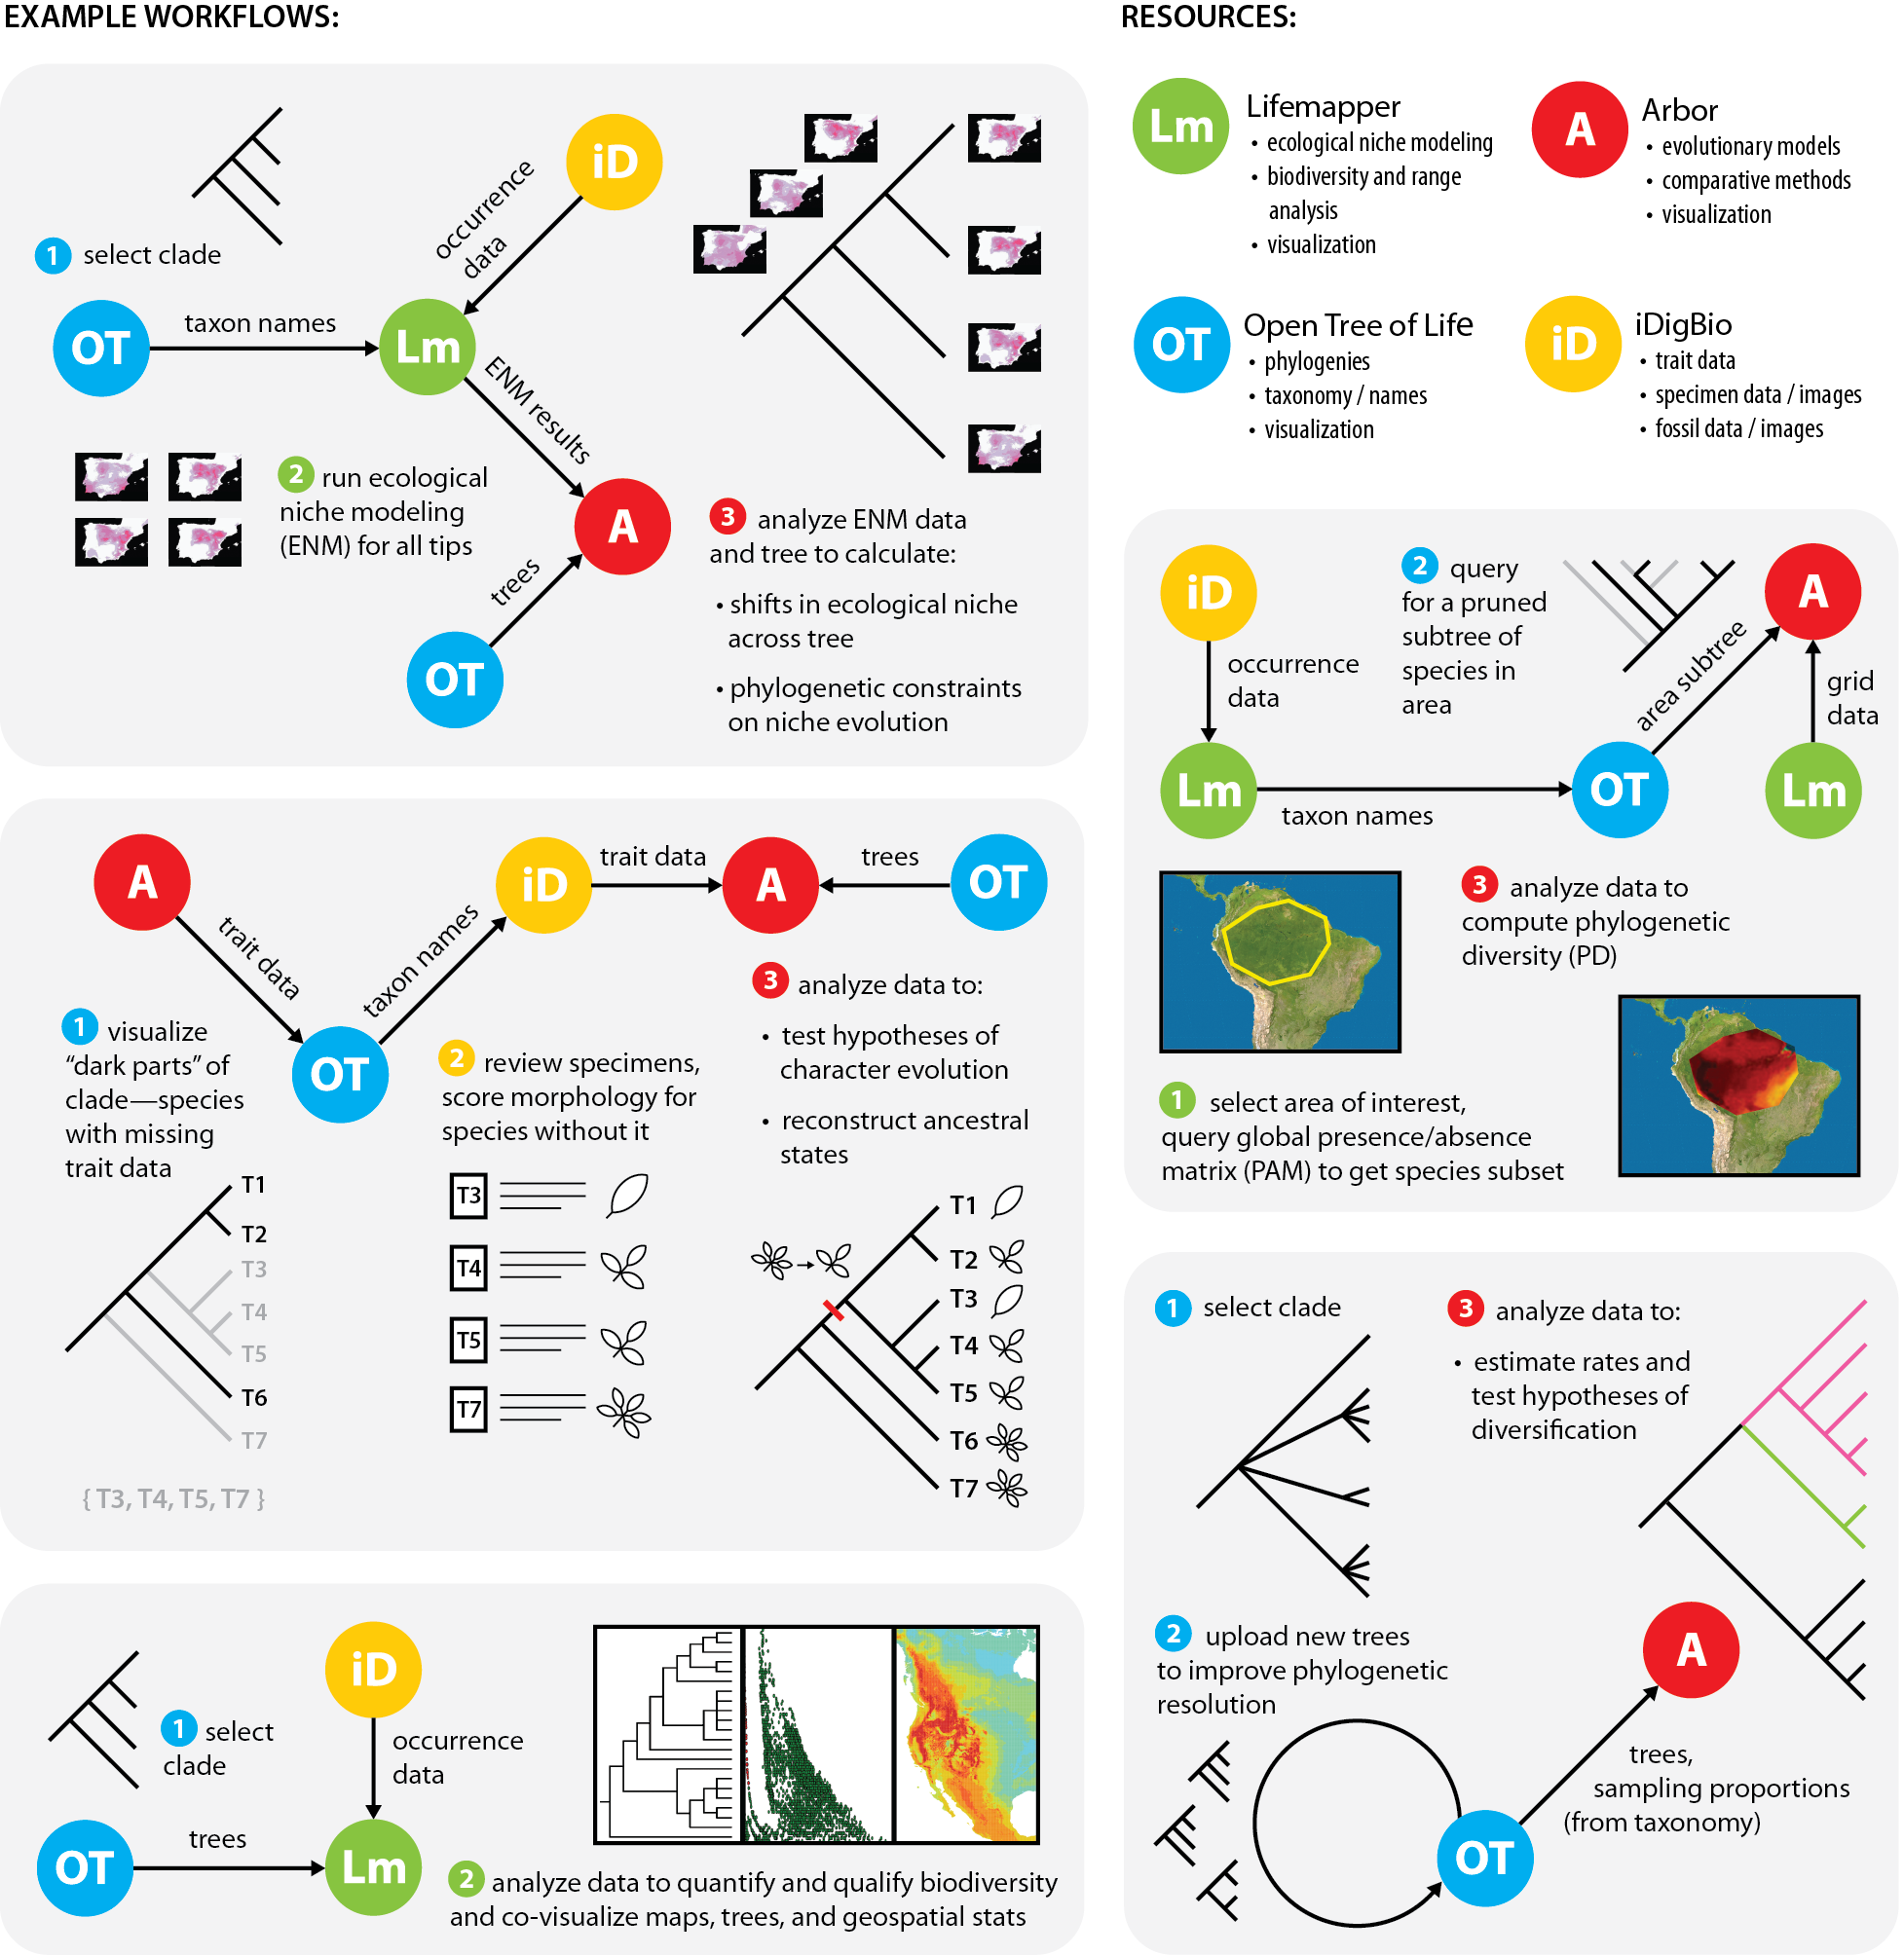

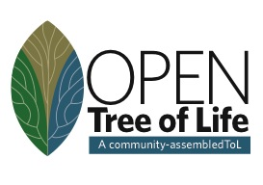

Connecting Specimens, Trees, Tools
Linking Heterogeneous Data:
BiotaPhy Project:
Connecting resources
to enable large-scale biodiversity analyses
J. Beach, D. Soltis, P. Soltis, J. Fortes,
S. Smith, R. Folk
Analytical Tools
Notes:
What we want to do today is highlight some of the exciting workflows our team is developing –so that you can see some of the possibilities that you may want to implement yourselves…using our platform deliverables and what ultimately should be easy to use workflows.. As originally conceived the goal of our first NSF-funded Biotaphy project was to connect specimens, trees, tools.. In Biotaphy 2—our current funding—we want to make workflows more accessible to the community

Slide 2
2:45 Introduction to the Biotaphy Project (Doug Soltis)
2:55 Overview of Phylogenetic Diversity (PD) related topics (Hannah Marx)
3:10 Hands-on PD Demo (Maria Cortez)
3:30 Overview of Alpine Biodiversity Project (Hector Figueroa)
3:40 Overview of OCBIL (Old, Climatically Buffered, Infertile Landscapes) Project
(Maria Cortez)
3:50 Correlating chromosome and climate evolution (Jon Spoelhof)
4:00 Computing with Heterogeneous Species Occurrence Data for Global Scale
Analyses (CJ Grady)
4:40 Q & A (All)
5:00 End
Notes:
Here is our game plan…short intro from Doug Soltis –then we will highlight our tool use and workflows with actual examples—test cases!!! As you listen—think, I want to do that…our goal with Biotaphy 2 is to make these work flows readily accessible

Slide 3
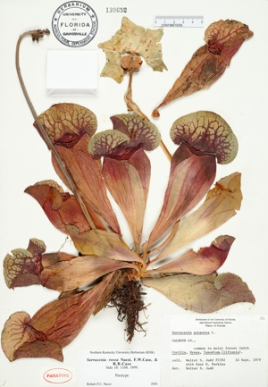
Label Data
Scientific name
Date
Collector
Location – state, county,
specific site,
GPS coordinates
Associated species

Slide 4
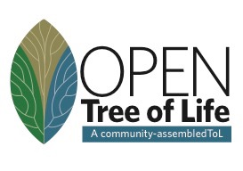
Trees

Slide 5
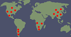



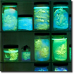



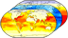
Lifemapper: Species Distribution Modeling
Species Occurrence Data
Predicted Habitat
Environmental Data
Notes:
Lifemapper calculates predicted habitat models using occurrence and environmental data---niche models on the fly

Slide 6
Connecting Specimens, Trees, Tools
5 Possible Workflows
Analytical Tools
Analytical Tools
C. Hinchliff
Notes:
In our original biotaphy proposal we proposed 5 possible workflows that we wanted to implement I know you can’t read these …so I will zoom in on a few

Slide 7
Connecting Trees, Specimens, Tools
Ancestral Niche
Analytical Tools
Notes:
One workflow that has been of great interest is to reconstruct ancestral niche. You have a Clade of interest- we need taxon names (OT) and occurrence data (iDigBio)— we can use those data to build niche models for all the tip species We also need a tree (build one or download one) and we can now examine niche shifts across the tree and look at phylogenetic constraints on niche evolution

Slide 8
Spatial Phylogenetics
Notes:
Another workflow of interest involves studies of spatial phylogenetics. A researcher selects an area of interest- here the Amazonian region but if could be Florida or a watershed in Ohio. You need a species list - occurrence data for those species. - and you need a tree for just those species. That tree can be obtained by pruning an existing tree to match your species list. You can then compute phylogenetic diversity (PD)-

Slide 9

Phylogenetic Diversity (PD):
how much of the Tree of Life is present in an area?
Oaks
Vs.
Notes:
Hannah will tell you more about PD next

Slide 10
PD – Genera of China Angiosperms
Low PD
High PD

Slide 11
Biotaphy 2: Goals
BiotaPhy Platform: community biodiversity gateway for data- intensive science
Increase accessibility and use of Open Tree of Life, iDigBio, and Lifemapper
A sustainable, long-term, biodiversity community infrastructure
Workshops
Notes:
The goal of Biotaphy 2 is to make workflows like these - and other workflows you will hear more about today- more readily available to general users. We want Our Biotaphy platform …

Slide 12
Biotaphy 2 Workflows
Launched
Workflows:
Developed
Workflows:
Notes:
So here are some workflows that have been launched at the top. READ
at the bottom are workflows that we have developed and are ready to launch READ---Advanced PD (you will see these); ancestral niche and paleoclimate range– Ryan Folk

Slide 13
BiotaPhy: Architecture
Notes:
Here is the project architecture – functions and communication between biotaphy subsystems; what is under the hood that most users will not have to worry about. But the general idea is that there are various sorts of input data on the left as discussed. The data access manager (DAM) responds to external user communications through client interfaces / then distributes the data and jobs internally. Compute management directs jobs to and from the compute engine —the workhorse of the software …to execute workflows
CJ will answer any questions you might have about this!

Slide 14
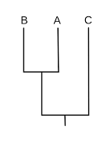

A project in need of a logo
Notes:
Finally—Biotaphy vs Biotaffy

Slide 15
2:45 Introduction to the Biotaphy Project (Doug Soltis)
2:55 Overview of Phylogenetic Diversity (PD) related topics (Hannah Marx)
3:10 Hands-on PD Demo (Maria Cortez)
3:30 Overview of Alpine Biodiversity Project (Hector Figueroa)
3:40 Overview of OCBIL (Old, Climatically Buffered, Infertile Landscapes) Project
(Maria Cortez)
3:50 Correlating chromosome and climate evolution (Jon Spoelhof)
4:00 Computing with Heterogeneous Species Occurrence Data for Global Scale
Analyses (CJ Grady)
4:40 Q & A (All)
5:00 End

